Slide 1


BUSINFO 703
Global Market Opportunities
Insights from Manufacturing, Trade & ML Segmentation
Group 6: Stella Goh
Xinyi Xu
Nicole Zhu

Slide 2


Introduction Summary
We combine global economic data and machine learning segmentation to identify where companies can compete, scale, and mitigate their expansion risk.
Our analysis highlights three structural differences across countries — manufacturing capability, trade position, and demand strength — and translates them into clear strategic pathways for market entry and growth.

Slide 3

Content
Macro Trends
Manufacturing Capabilities across Regions
Trade Flows & Demand Hotspots
Market Segmentation
Strategic Implications

Slide 4

Macro Trends
Global demand is highly concentrated in a few large economies
Trade is more fluctuating than GDP, signaling external risks
Regions follow different growth paths — East Asia shows strong performance, while other regions grow more slowly

Slide 5



Manufacturing Capability Across Regions
The manufacturing capacity is concentrated in a few countries, which brings about economies of scale and risks of concentration
Manufacturing output varies significantly across various regions. The East Asia and Pacific region, as well as North America, dominate global output
Market attractiveness cannot be determined solely based on the scale of output

Slide 6

Trade Flows & Demand Hotspots
The countries where exports exceed imports are the strong suppliers in the global market
The countries where imports exceed exports are markets with strong demand
The upward trend indicates an increase in supply, while the long-term downward trend indicates a sustained demand
Notes:
So, if goods are made here, where do they go?
Trade flows show two main roles: some countries mainly send products out, while others mainly bring them in.
…..mainly to nearby markets rather than driving global sourcing.
supply-heavy regions help lower costs, but demand-heavy markets are where companies earn revenue.

Slide 7
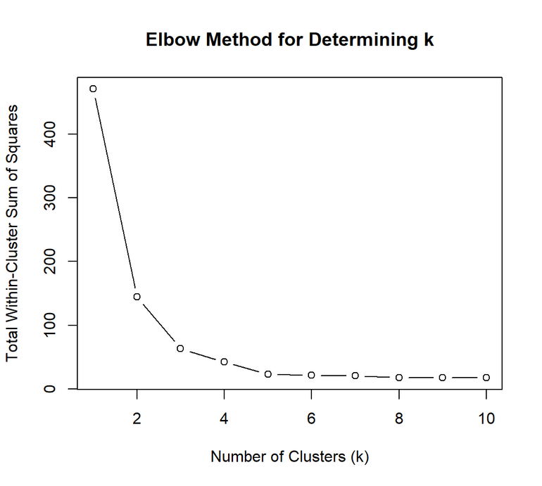

Market Segmentation
K-Means Clustering
Objective
Segment over 150 countries based on trade and manufacturing indicators.
Data Used
Average Export
Average Import
Average Manufacturing
All variables standardized.
Method
Elbow method

Slide 8
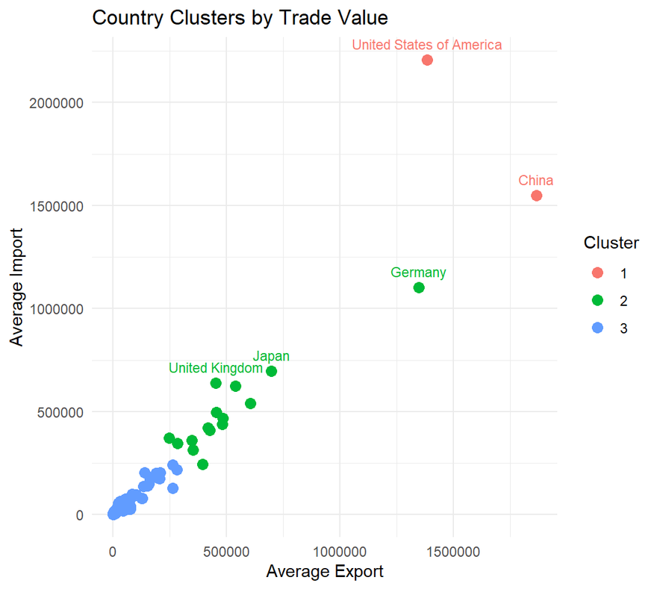
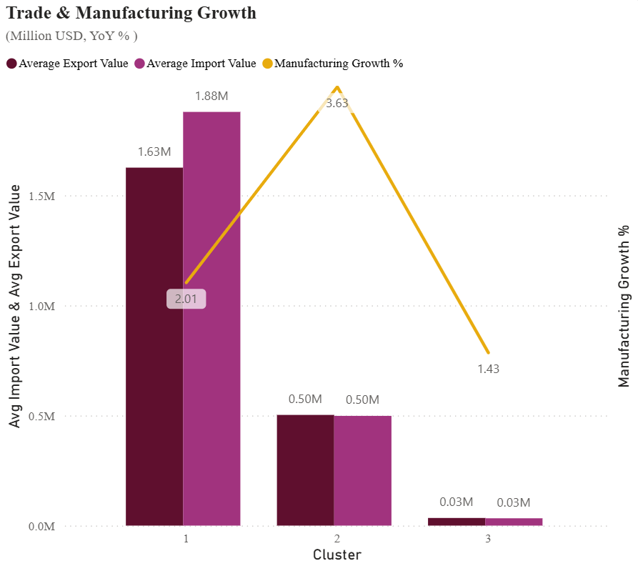
Market Segmentation
Outcome
3 distinct clusters based on trade and manufacturing profiles.
Reveal differences in economic scale and trade intensity.

Slide 9
Strategic Implications
Cluster 1 — Mature Markets
Build strong brands while keeping costs low.
Example: Sell flagship products in the US; source components from China.
Cluster 2 — Emerging Growth Markets
Use local assembly to reduce tariffs and enter markets faster.
Example: Finish packaging in India; sell on Shopee/Lazada.
Cluster 3 — Low-Risk Exploratory Markets
Test demand online before making heavy investments.
Example: List basic products on AliExpress/Amazon; expand only if sales grow.

Slide 10

Thank You!
Group 6

Slide 11
Appendix
International_Trade. https://stats.wto.org/inventory/en
Manufacturing, value added (annual % growth). https://data.worldbank.org/indicator/NV.IND.MANF.KD.ZG
World GDP(GDP, GDP per capita, and annual growths). https://www.kaggle.com/datasets/zgrcemta/world-gdpgdp-gdp-per-capita-and-annual-growths

